Slide 1
CAMERAS
Slides are from Svetlana Lazebnik

Slide 2
Overview
Cameras with lenses
Depth of field
Field of view
Lens aberrations
Digital sensors

Slide 3
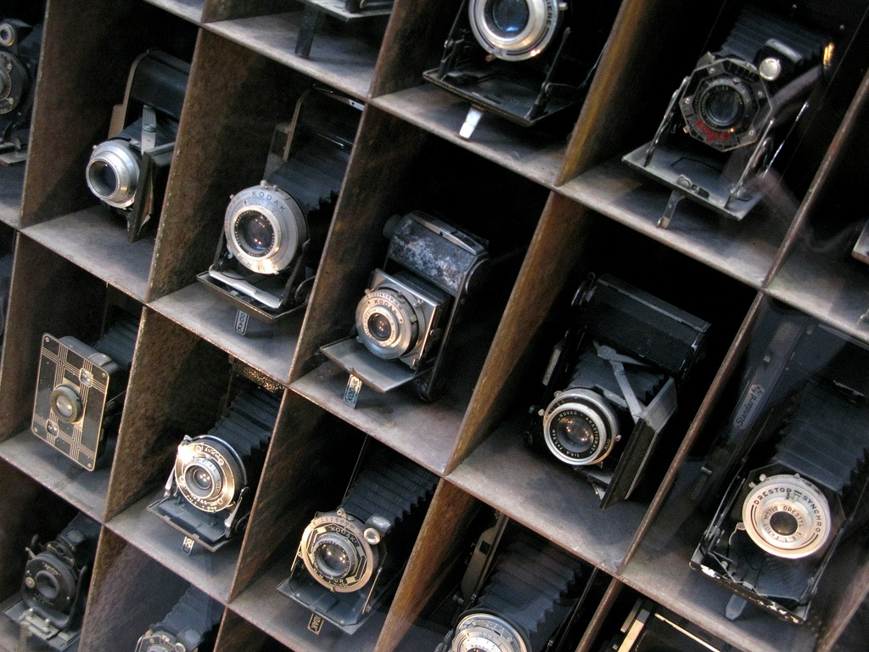
Understanding Real Cameras

Slide 4
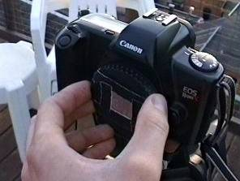
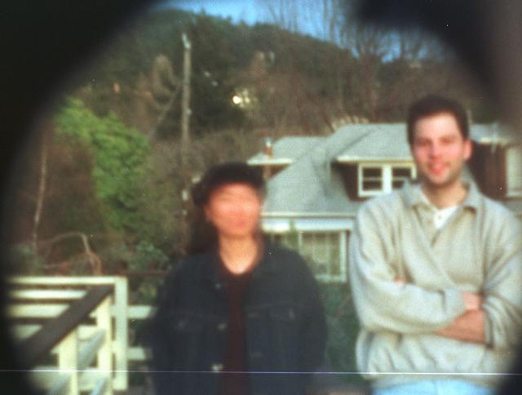
Home-Made Pinhole Camera
Slide by A. Efros
http://www.debevec.org/Pinhole/

Slide 5
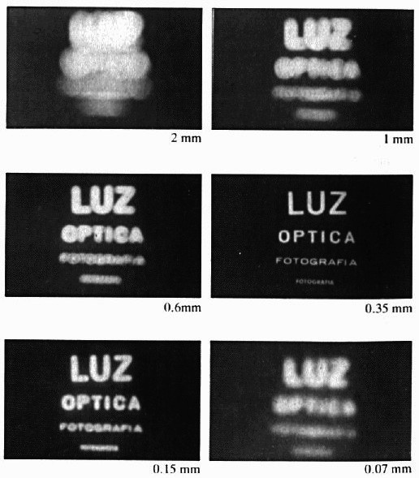
Shrinking the Aperture
Why not make the aperture as small as possible?
Less light gets through
Diffraction effects…
Slide by Steve Seitz

Slide 6
Shrinking the Aperture

Slide 7
Adding a lens

Slide 8
Adding a Lens
A lens focuses light onto the film
Thin lens model:
Rays passing through the center are not deviated (pinhole projection model still holds)
Slide by Steve Seitz

Slide 9
Adding a Lens
focal point
f
A lens focuses light onto the film
Thin lens model:
Rays passing through the center are not deviated (pinhole projection model still holds)
All parallel rays converge to one point on a plane located at the focal length f
Slide by Steve Seitz

Slide 10
Adding a Lens
“circle of
confusion”
A lens focuses light onto the film
There is a specific distance at which objects are “in focus”
other points project to a “circle of confusion” in the image
Slide by Steve Seitz

Slide 11
Thin Lens Formula
What is the relation between the focal length ( f ), the distance of the object from the optical center (D), and the distance at which the object will be in focus (D′)?
D′
D
f
image plane
lens
object
Slide by Frédo Durand
Notes:
This is the relation between the focal length (f), the distance of the object from the camera (D), and the distance at which the object will be in focus (D’)

Slide 12
Thin Lens Formula
Similar triangles everywhere!
D′
D
f
image plane
lens
object
Slide by Frédo Durand

Slide 13
Thin Lens Formula
y′/y = D′/D
Similar triangles everywhere!
D′
D
f
y
y′
image plane
lens
object
Slide by Frédo Durand

Slide 14
Thin Lens Formula
y′/y = D′/D
Similar triangles everywhere!
y′/y = (D′−f )/f
D′
D
f
y
y′
image plane
lens
object
Slide by Frédo Durand

Slide 15
Thin Lens Formula
1
1
1
Any point satisfying the thin lens equation is in focus.
+
=
D′
D
f
D′
D
f
image plane
lens
object
Slide by Frédo Durand
Notes:
And the set of all such points forms a plane parallel to the image (plane of focus).
Uses of the formula: given focal length and depth in scene that you want to be in focus, it tells you where to put the image plane. Given f and distance of image plane from camera center, it tells you which depth in the scene will be in focus.

Slide 16
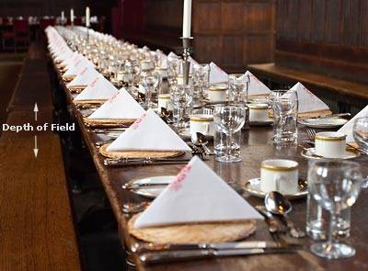
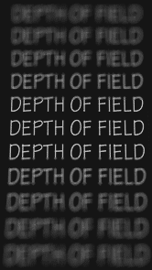
Depth of Field
http://www.cambridgeincolour.com/tutorials/depth-of-field.htm
Slide by A. Efros
Notes:
Depth of field is the distance between the nearest and farthest objects in a scene that appear acceptably sharp in an image (Wikipedia)

Slide 17
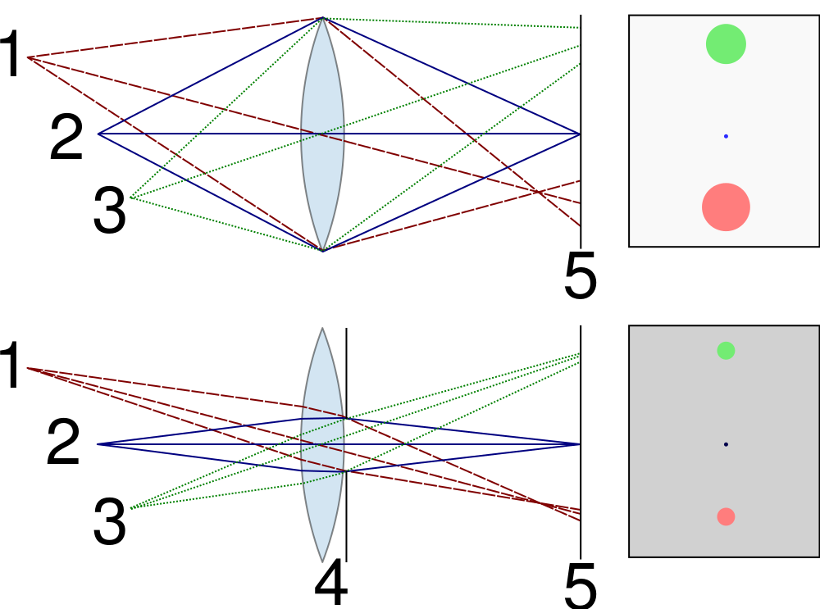


Controlling Depth of Field
Changing the aperture size affects depth of field
A smaller aperture increases the range in which the object is approximately in focus
But small aperture reduces amount of light – need to increase exposure
http://en.wikipedia.org/wiki/File:Depth_of_field_illustration.svg

Slide 18
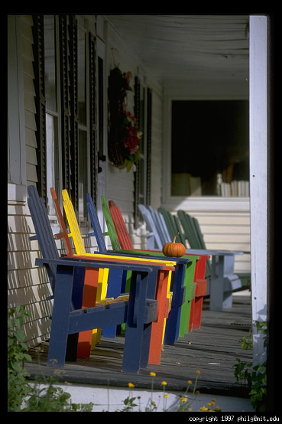
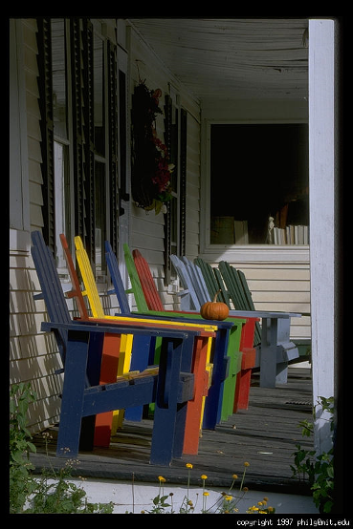
Varying the Aperture
Large aperture = small DOF
Small aperture = large DOF
Slide by A. Efros

Slide 19
Field of view
The field of view is the angular extent of the world observed by the camera (Wikipedia)
What determines the FOV?
Source: Lazebnik.

Slide 20
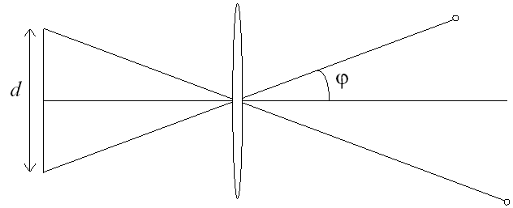
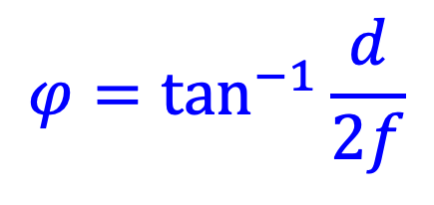
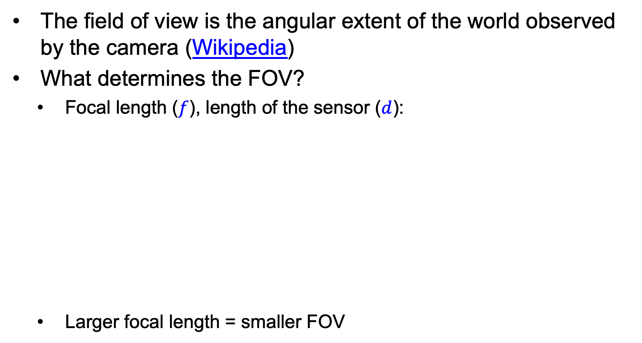
Field of view
The field of view is the angular extent of the world observed by the camera (Wikipedia)
What determines the FOV?
Focal length ($f$), length of the sensor ($d$):
Larger focal length = smaller FOV
f
$$φ=\tan^{−1}{\frac{d}{2f}}$$
Source: Lazebnik.

Slide 21
Field of View
Slide by A. Efros
Notes:
The field of view is the angular extent of the world that is observed by the camera.

Slide 22
Field of View
Slide by A. Efros

Slide 23
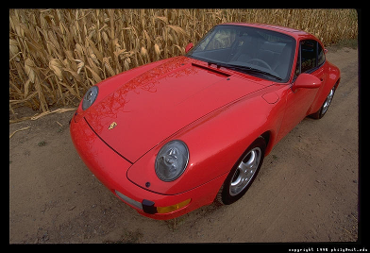
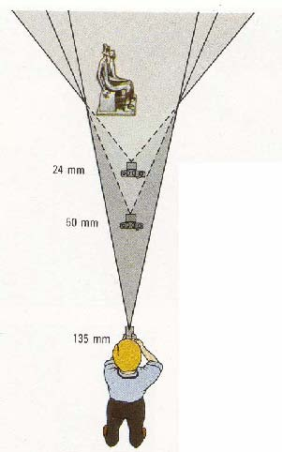
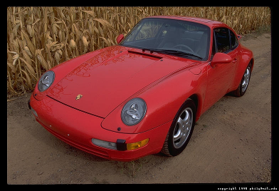
Field of View / Focal Length
Large FOV, small f
Camera close to car
Small FOV, large f
Camera far from the car
Sources: A. Efros, F. Durand

Slide 24
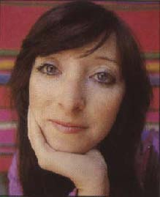


Same Effect for Faces
wide-angle
standard
telephoto
Source: F. Durand

Slide 25
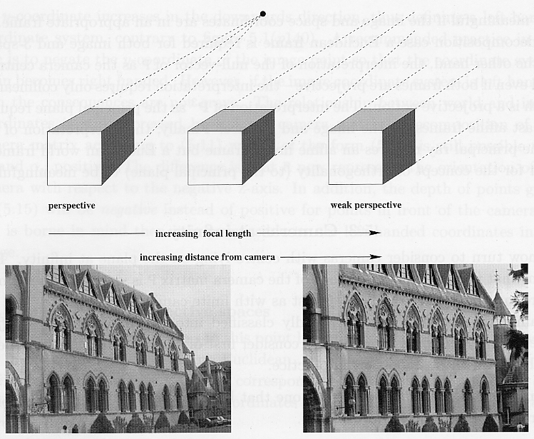
Approximating an Orthographic Camera
Source: Hartley & Zisserman

Slide 26
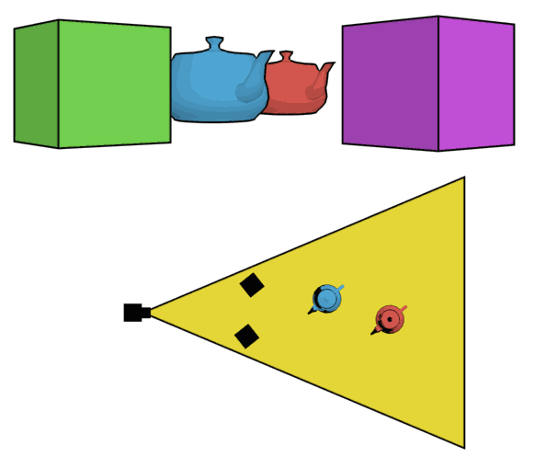
The Dolly Zoom
Continuously adjusting the focal length while the camera moves away from (or towards) the subject
http://en.wikipedia.org/wiki/Dolly_zoom

Slide 27
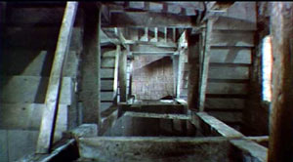
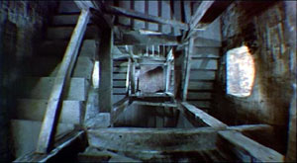
The Dolly Zoom
Continuously adjusting the focal length while the camera moves away from (or towards) the subject
“The Vertigo shot”
Example of dolly zoom from Goodfellas (YouTube)
Example of dolly zoom from La Haine (YouTube)

Slide 28
Choice of Lens and Viewpoint: A COVID-Era Illustration
Source

Slide 29
Overview
Cameras with lenses
Depth of field
Field of view
Lens aberrations

Slide 30
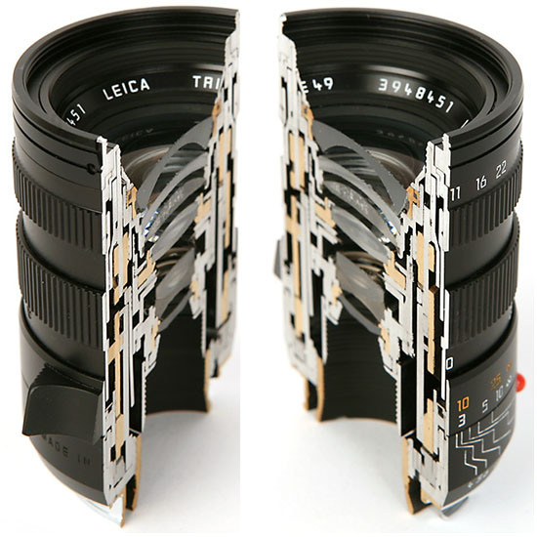
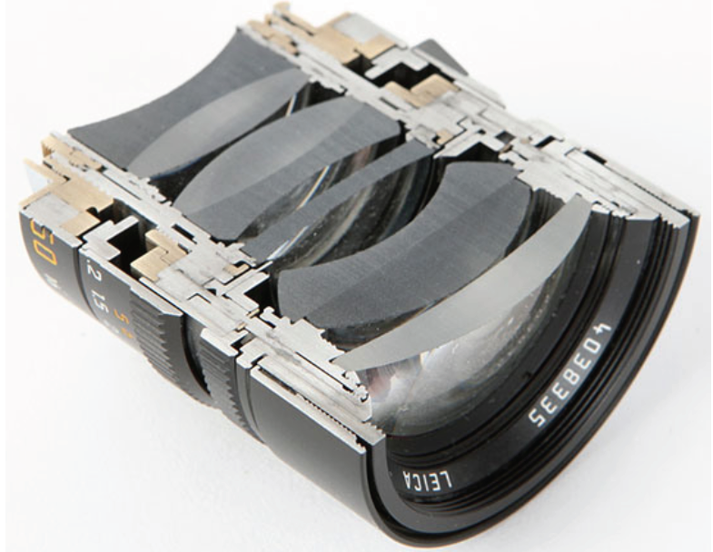
Real Lenses

Slide 31
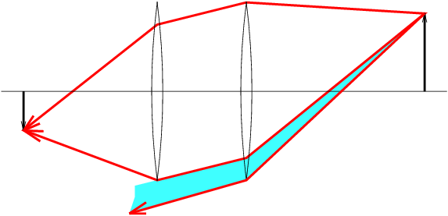
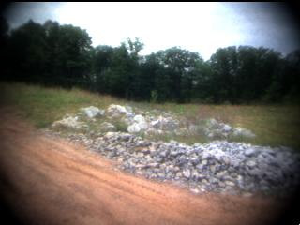
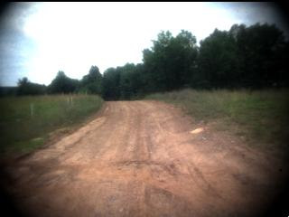
Lens Flaws: Vignetting

Slide 32
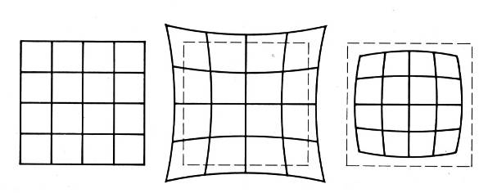
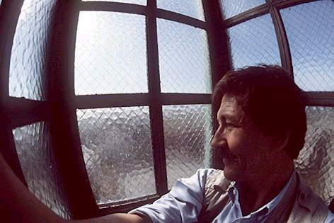
Lens Flaws: Radial Distortion
Caused by imperfect lenses
Deviations are most noticeable near the edge of the lens
No distortion
Pin cushion
Barrel

Slide 33
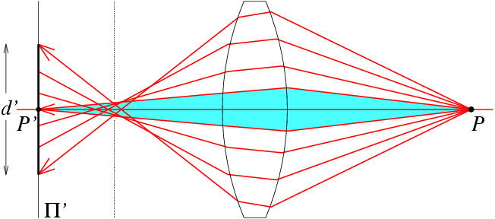
Lens flaws: Spherical Aberration
Spherical lenses don’t focus light perfectly
Rays farther from the optical axis focus closer

Slide 34
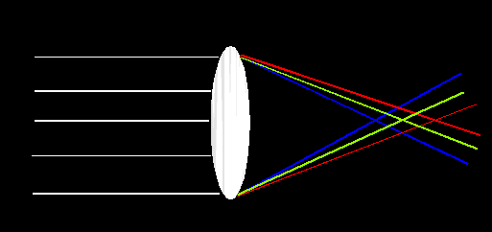
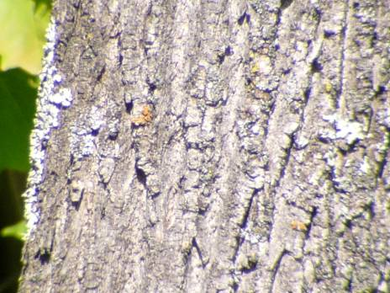
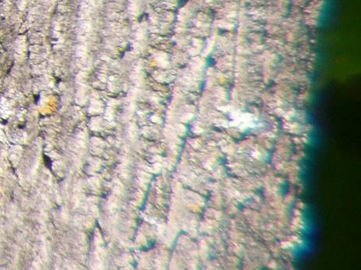
Lens Flaws: Chromatic Aberration
Lens has different refractive indices for different wavelengths: causes color fringing
Near Lens Center
Near Lens Outer Edge

Slide 35
Overview
Cameras with lenses
Depth of field
Field of view
Lens aberrations
Digital sensors

Slide 36
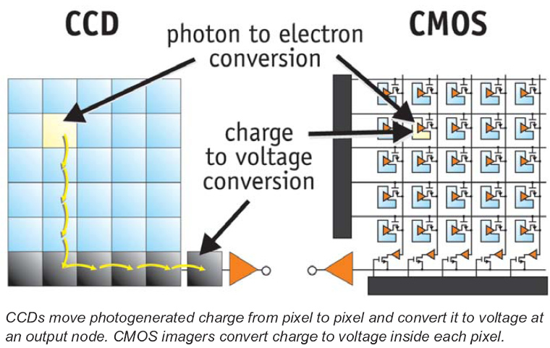
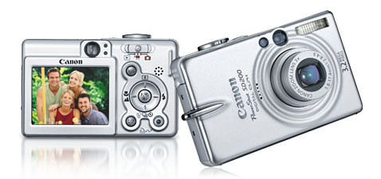
Digital Camera
A digital camera replaces film with a sensor array
Each cell in the array is light-sensitive diode that converts photons to electrons
Two common types
Charge Coupled Device (CCD)
Complementary metal oxide semiconductor (CMOS)
http://electronics.howstuffworks.com/digital-camera.htm
Slide by Steve Seitz

Slide 37
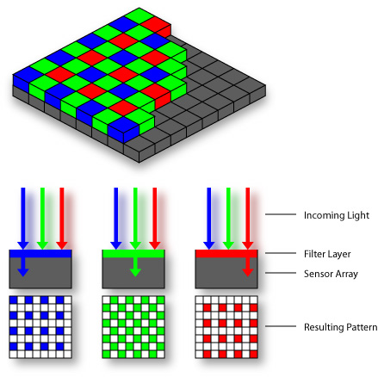

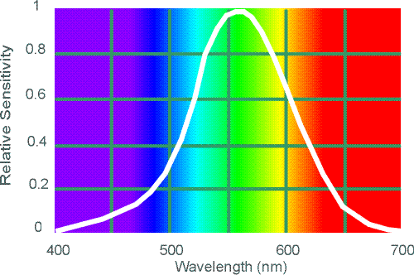
Color filter arrays
Bayer grid (1976)
Demosaicing:
Estimation of missing components from neighboring values
Why more green?
Human Luminance Sensitivity Function
Source: Steve Seitz

Slide 38
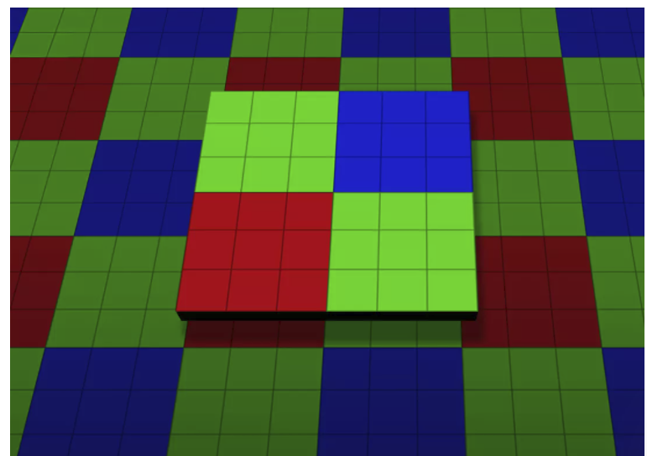
Color filter arrays
Bayer grid (1976)
Demosaicing:
Estimation of missing components from neighboring values
Recent cameraphone technology: pixel binning

Slide 39

Problem with Demosaicing: Color Moire
Slide by F. Durand

Slide 40
The Cause of Color Moire
detector
Fine black and white detail in image
misinterpreted as color information
Slide by F. Durand

Slide 41


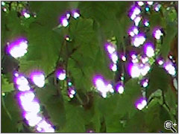
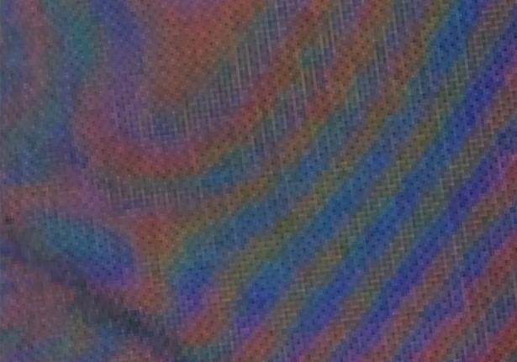
Misc. digital camera artifacts
Noise
low light is where you most notice noise
light sensitivity (ISO) / noise tradeoff
stuck pixels
In-camera processing
oversharpening can produce halos
Compression
JPEG artifacts, blocking
Blooming
CCD charge overflowing into neighboring pixels
Color artifacts
Color moire
Purple fringing from microlenses

Slide 42
Digital Camera Artifacts
Noise
low light is where you most notice noise
light sensitivity (ISO) / noise tradeoff
stuck pixels
In-camera processing
oversharpening can produce halos
Compression
JPEG artifacts, blocking
Blooming
charge overflowing into neighboring pixels
Color artifacts
purple fringing from microlenses,
white balance
Slide by Steve Seitz

Slide 43
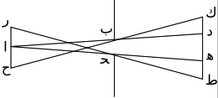
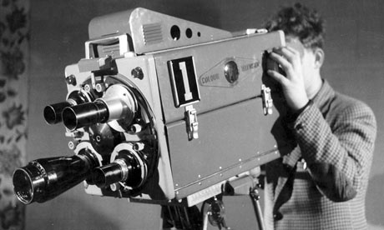
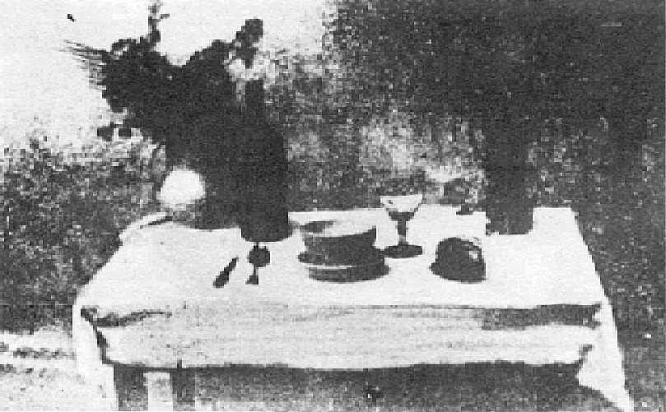
Historic Milestones
Pinhole model: Mozi (470-390 BCE), Aristotle (384-322 BCE)
Principles of optics (including lenses): Alhacen (965-1039 CE)
Camera obscura: Leonardo da Vinci (1452-1519), Johann Zahn (1631-1707)
First photo: Joseph Nicephore Niepce (1822)
Daguerréotypes (1839)
Photographic film (Eastman, 1889)
Cinema (Lumière Brothers, 1895)
Color Photography (Lumière Brothers, 1908)
Television (Baird, Farnsworth, Zworykin, 1920s)
First consumer camera with CCD Sony Mavica (1981)
First fully digital camera: Kodak DCS100 (1990)
Alhacen’s notes
Niepce, “La Table Servie,” 1822
Old television camera

Slide 44
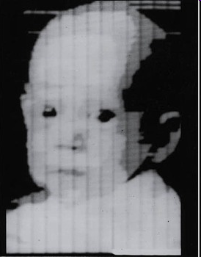
First Digitally Scanned Photograph
1957, 176x176 pixels
http://listverse.com/history/top-10-incredible-early-firsts-in-photography/
Notes:
From the website: “Russell Kirsch was a computer pioneer at the National Institute of Standards and Technology in the USA when he developed the system by which a camera could be fed into a computer. The photo is of Kirsch’s three month old son Walden and it measured a mere 176×176 pixels. Baby Walden now works in communications for Intel.”

Slide 45
Camera Sales Over Time
Source
Notes:
CIPA: Camera & Imaging Products Association

Slide 46
Camera Sales Over Time
The full chart…
More information on color and cameras:
https://www.eecs.yorku.ca/~mbrown/ICCV19_Tutorial_MSBrown.pdf
Source
Notes:
CIPA: Camera & Imaging Products Association

